Slide 1
Protect your ideas
An introduction to patents for students of natural sciences, engineering, medicine and business administration
http://www.epo.org/learning-events/materials/kit/about.html

Slide 2
Learning goals
Understand what intellectual property is about
Balance the pros and cons of applying for a patent
  Understand what a patent is
  Know how to obtain a patent and how much it costs
  Understand how patents can be used
  Be aware of the alternatives to patenting
Use patent information to gain valuable knowledge

Slide 3
What is Intellectual Property
Legal products of your mind
Forms and examples?
  Copyright – Music, books…
  How is plagiarism related?
  Trademarks – Google, Yahoo!, Apple
  Trade secrets – Secret formula for Coca Cola
  Plant and utility patents – Bt corn, agrobacterium, gene gun
Patents are the primary IP used in Engineering

Slide 4
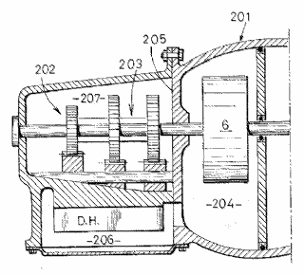




Overview of intellectual property
Legal right
What for?
How?
Patents
New inventions
Application and examination
Copyright
Original creative or artistic forms
Exists automatically
Trade marks
Distinctive identification of products or services
Use and/or
registration
Registered designs
External appearance
Registration*
Trade secrets
Valuable information not known to the public
Reasonable efforts to keep secret
Notes:
Patents: Only inventions can be patented and they will be disclosed to the public. The patent office will examine the patent application to determine whether the stringent requirements for a patent grant are met.
Copyright: Copyright includes, for example, literature, art, drama, music, photographs, recordings, broadcasts, etc.
Trade marks: Trade marks are distinctive signs or indicators of the source of a product or service, e.g. names, logos, colours applied to the owner's products or services, which distinguish them from products or services provided by competitors.
Registered designs: Registered designs protect the external appearance of a product. They do not give any protection for technical aspects. They include new patterns, ornaments and shapes. To be officially registered, designs need to be original and distinctive. The artistic aspects of a design may also be protected by copyright.
Unregistered designs also enjoy some protection. An unregistered design is a free, automatic right that you get when you present a design to the public. It gives you the right to stop anyone from copying your design but typically the protection afforded by an unregistered design is of more limited duration than that available for a registered design.
Trade secrets: This is an alternative to patents. Trade secrets cover information not known to the public. If the possessor of such information is careful to keep the information confidential (e.g. by signing non-disclosure agreements with employees/partners) he can sue anyone who steals it. However, trade secrets offer no protection against reverse-engineering or against competitors who independently make the same invention.

Slide 5
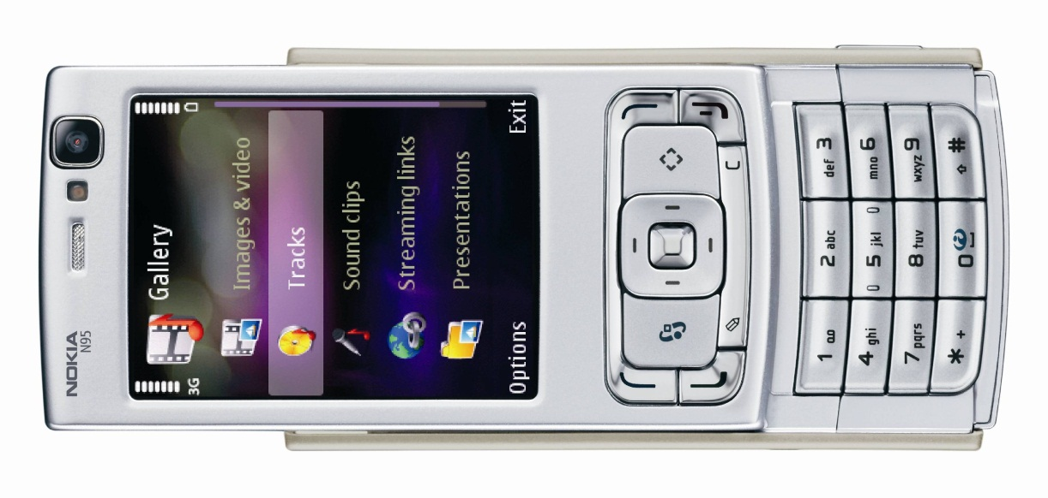
Some IP found in a mobile phone
Trade marks:
Made by "Nokia"
Product "N95"
Software "Symbian", "Java"
Patents:
Data-processing methods
Semiconductor circuits
Chemical compounds
…
Copyrights:
Software code
Instruction manual
Ringtone
…
© Nokia
Trade secrets:
?
Designs (some of them registered):
Form of overall phone
Arrangement of buttons in oval shape
Three-dimensional wave form of buttons
…

Slide 6
Importance of intellectual property
Essential business asset in the knowledge economy
  Swedish steel-maker Sandvik: 20% of its value is from IP!
Increases funding for innovative projects
  Without IP many innovative projects would not be profitable because anyone who wanted could simply copy the results
Protects small innovative firms
  Dolby® Laboratories
  W. L. Gore & Associates (Gore-Tex®)
Needed to release IP into the public domain under
controlled conditions:
  Linux (GPL): improvements must be free too!
Notes:
Note: Sandvik's subsidiary company, which holds the IP, has only 12 employees and has a book value of EUR 1800 million (in 2007).
Dolby Laboratories
Invented noise-reduction technology in the 1960s.
Used a combination of patents to protect the technology and trade marks.
Became a successful high-tech company.
W.L. Gore
Founded by the Gore family in the basement of their house in 1958.
PTFE (Teflon®) related high-tech products.
Patent protection and strong trade marks (Gore-Tex®).
Now has 8 000 employees.
Additional examples for audiences familiar with the concept of licensing technology:
ARM Ltd.
Develops energy-efficient microprocessors but does not make them (earns licensing royalties)
Founded 1990, now market leader in microprocessors for mobile phones
ARM founder Hermann Hauser: "I gave (the design team) two things which National, Intel and Motorola had never given their design teams: the first was no money; the second was no people. The only way they could (design a microprocessor) was to keep it really simple."
LINUX:
The Linux operating system and other open source software are free to use, but users must accept the general public licence (GPL), which includes an agreement to put any improvements under the GPL too.
Creative Commons:
A range of sample licences for books, software, photos, etc. Authors may grant free use but require, for example, that their names be stated or that use be non-commercial.

Slide 7
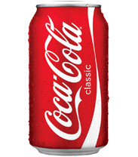

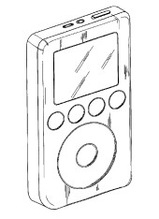
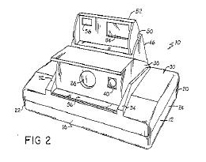
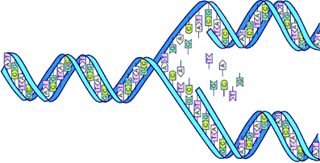
Examples of valuable intellectual property
Optional
Harry Potter
Coca-Cola®
Apple® iPod®
Instant camera
DNA copying process
Notes:
Coca-Cola: Brand worth EUR 27 000 million according to various market research firms. TRADE MARK
Apple iPod: More than 100 million units sold. TRADE MARK, REGISTERED DESIGNS, PATENTS (user interface)
Harry Potter: Author J.K. Rowling converted her imagination to the equivalent of 42 thousand kilos of gold – true intellectual property magic (she earned approximately EUR 750 Million from her COPYRIGHT).
Instant camera: Kodak had to pay EUR 550 million to Polaroid for having illegally used Polaroid's patented inventions.
DNA copying process: Nobel Prize-winning technology was patented, PATENT sold for EUR 190 million.
Compare the value of IP with the Hope Diamond (a famous large blue diamond): EUR 125 million.

Slide 8
ARM LDT
A company with a business model based on IP
http://www.arm.com/about/company-profile/index.php
ARM founder Hermann Hauser: "I gave (the design team) two things which National, Intel and Motorola had never given their design teams: the first was no money; the second was no people. The only way they could (design a microprocessor) was to keep it really simple."

Slide 9
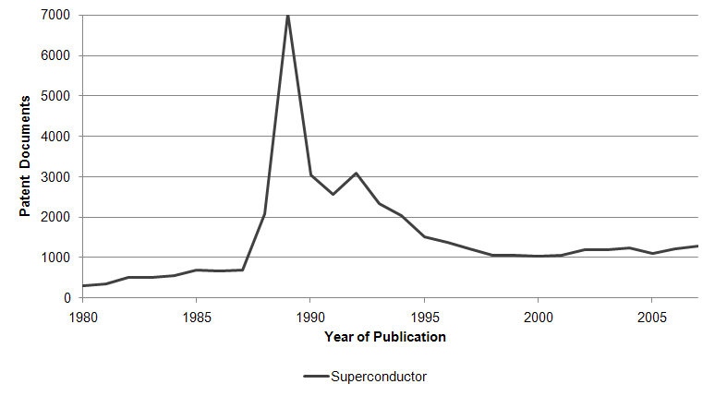
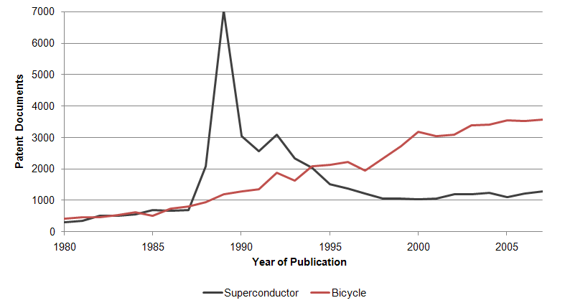
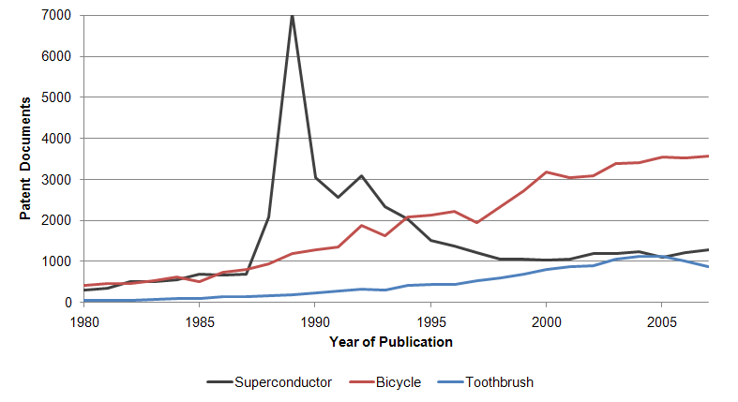
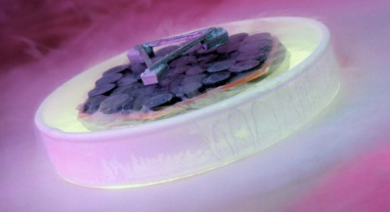
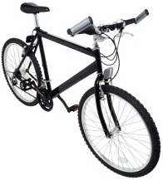
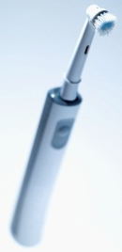
Patents are all around us
Optional
Major discovery
Notes:
Superconductors
1987: Nobel Prize in Physics for high-temperature superconductors invented in 1986.
No substantial market until today
Bikes:
100 million bikes sold every year!
Toothbrushes:
Well in excess of one billion sold every year (one plant reportedly manufactures 900 million a year)
Data sources: The chart shows the number of patent documents found on the free worldwide patent database at www.espacenet.com. A search for the keywords 'bicycle or bike or bicyclette or Fahrrad', 'toothbrush or Zahnbürste' and 'superconduct*' was performed. The production figures for bicycles and cars were taken from reports by the Earth Policy Institute, the US National Bicycle Dealers Association, and the International Organization of Motor Vehicle Manufacturers.

Slide 10
The first account of a "patent system"
Optional
In the ancient Greek city of Sybaris (destroyed in 510 BC), leaders decreed:
"If a cook invents a delicious new dish, no other cook is to be permitted to prepare that dish for one year.
During this time, only the inventor shall reap the commercial profits from his dish. This will motivate others to work hard and compete in such inventions."
First patent in US 1790 – proces of making potash for fertilizer.
Notes:
Aim:
To motivate people to innovate, which is identical to the main aim of today's patent system.

Slide 11
The patent system
Senate of Venice, 1474:
"Any person in this city who makes any new and ingenious contrivance, not made heretofore in our dominion, shall, as soon as it is perfected so that it can be used and exercised, give notice of the same to our State Judicial Office, it being forbidden up to 10 years for any other person in any territory of ours to make a contrivance in the form and resemblance thereof".
Today:
New to the world (Europe); up to 20 years of protection
Incentive to innovate (grant protection)
Incentive to share knowledge (publish the invention's details)
Notes:
Venice patent law:
Invention new to a certain region
10 years
Details not published
Galileo: patent on water pump in 1594
Today:
New to the world (European law)
20 years
Details published
Main goals of today's patent system:
(a) Incentive to innovate (protect results so the inventor can reap benefits -> makes it easier to attract investment)
(b) Incentive to share knowledge (to get protection the inventor must publish the details; patent databases promote technology transfer)
This dual nature of the patent system is sometimes referred to as a contract between society (which gets the knowledge) and the inventor (who gets the exclusive rights).

Slide 12
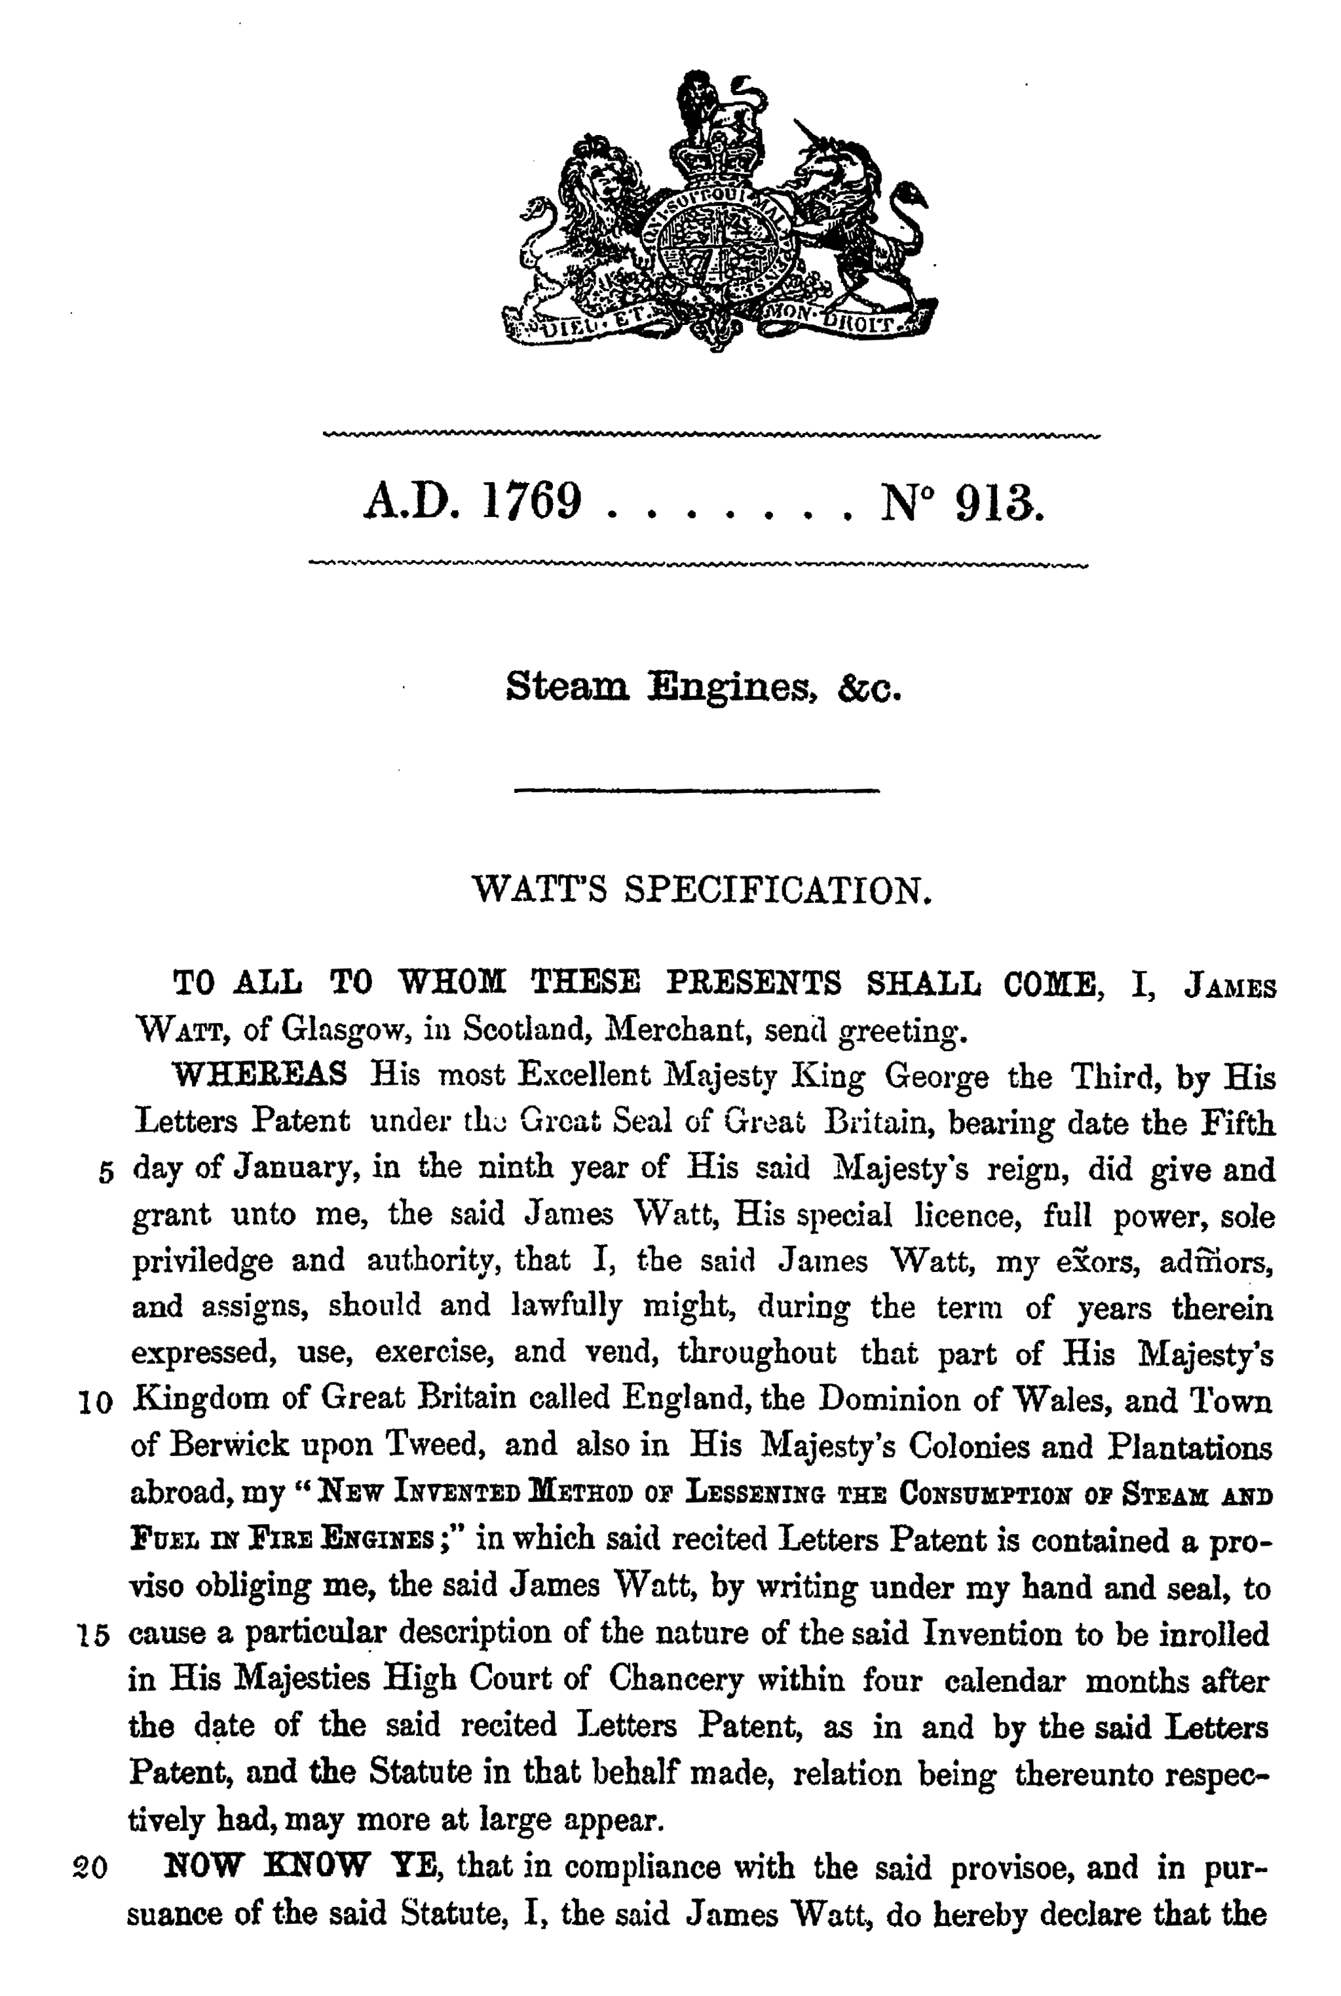
GB patent No. 1769-913: Watt's improved steam engine
Optional
Notes:
The breakthrough steam engine patent granted to Watt related to a "New Invented Method of Lessening the Consumption of Steam and Fuel in Fire Engines".
Contained separate condenser to condense the steam outside the cylinder
Reduced fuel consumption by 60%
Increased the power available from a cylinder of a given size.
Note that this is the 913th patent of the year 1769. It is not the 913th patent since 1617. Patents were issued in the same number sequence each year. So there would be a patent number 913 in 1769, 1770, 1771 and so on.

Slide 13
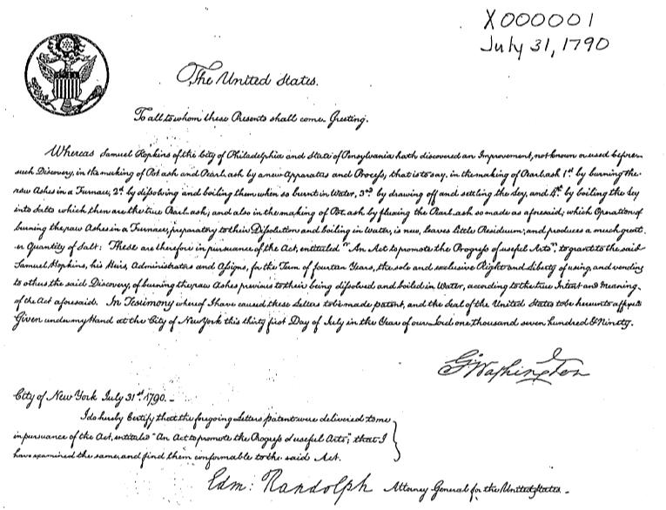
First Patent in US 1790 – Process of making potash for fertilizer

Slide 14

IF you hold a patent on an antibody for curing cancer – does the patent grant you right to sell the antibody to others?
1) Yes
Send 'AU PK 1' to 42420321
2) No
Send 'AU PK 2' to 42420321
3) Can not conclude on the given information
Send 'AU PK 3' to 42420321
Std. rates apply. No premium charges
<number>/8

Slide 15
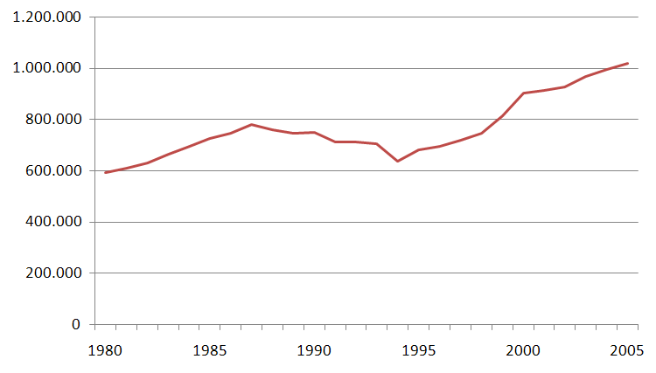
Number of patent applications per year worldwide
Optional
Number of inventions
for which patent protection sought
Year in which application filed
Notes:
The graph shows the number of inventions ("patent families") for which patent applications have been filed at around 80 patent offices worldwide.
The actual total number of individual patent applications around the world is much higher, as many companies apply for patents for the same invention in more than one country.
Trends in patenting mirror technological and economic development.
The next slide shows which countries have driven growth since the mid-1990s
Source: the EPO's PATSTAT database.

Slide 16
A patent only cover your invention in the country in which you have applied for patent protection

Slide 17
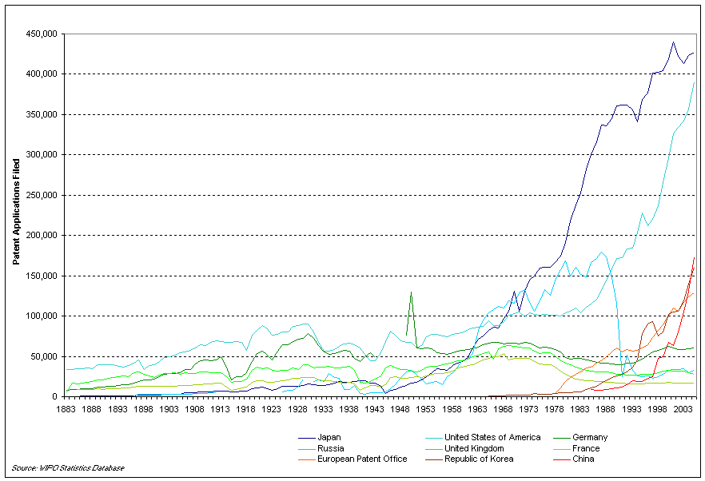
Filing rates at selected patent offices
Optional
Notes:
This chart: patent applications per office (the same invention may appear multiple times if patented in multiple countries).
High growth rate since the end of World War II reflects the technological and economic prosperity of the post-war period.
In the last two decades: high growth rate in Korea (from 1983) and China (from 1998) reflects the increasing economic importance of these two countries (many of the patent applications in these countries are filed by foreign - i.e. European and US-based - companies).
Note the large number of patent applications in the Soviet Union. From the employee-inventor perspective (who in our current system effectively does not in most cases own his own invention), the two patent systems (communist and capitalist) might often not have been so different: Both systems effectively provided employee inventors with public recognition and a small monetary compensation.
More statistics are available at: http://www.wipo.int/ipstats/en/statistics/patents/index.html

Slide 18
US – First to INVENT
EU – First to FILE

Slide 19
Types of Patents
Utility
    Plant
        Design

Slide 20
Utility Patent
Whoever invents or discovers any new and useful process, machine, manufacture, or composition of matter, or any new and useful improvement thereof, may obtain a patent therefor, subject to the conditions and requirements of this title. (35 U.S.C. § 101)

Slide 21
Plant Patents
Whoever invents or discovers and asexually reproduces any distinct and new variety of plant, including cultivated spores, mutants, hybrids, and newly found seedlings, other than a tuber propagated plant or a plant found in an uncultivated state. . . (35 U.S.C. § 161)
  No bacteria or similar single-cell organisms need apply!

Slide 22
Design Patents
Whoever invents any new, original, and ornamental design for an article of manufacture may obtain a patent. (35 U.S.C. § 171)

Slide 23

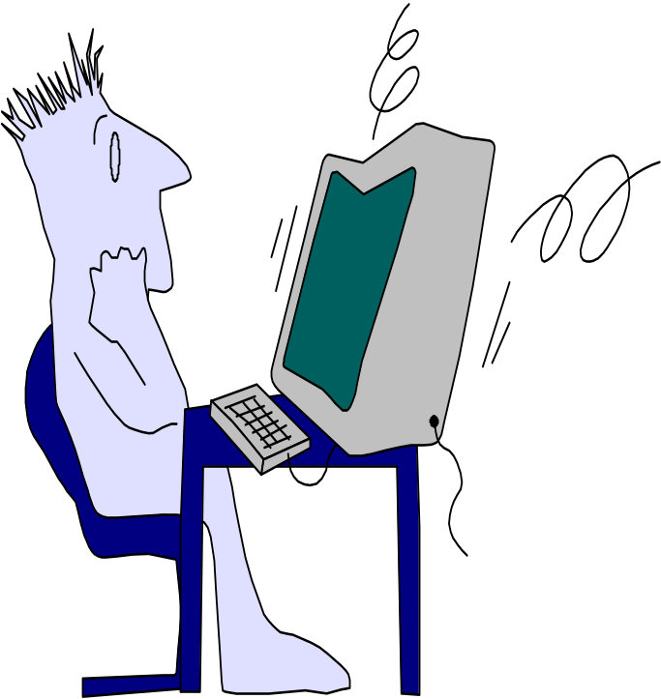
INVENTION PATENTABLE IF........
NEW
USEFUL
NOT OBVIOUS

Slide 24
Rights conferred by the patent
Prevent others from making, using, offering for sale, selling or importing infringing products in the country where the patent was granted
Sell these rights or conclude licensing contracts
For up to 20 years from the date of filing of the patent application
The patent does not grant the right to use the invention!
A patent search
is indispensable!!!
Notes:
The legal rights conferred by patents do NOT extend to:
acts done privately and for non-commercial purposes
acts done for experimental purposes relating to the subject matter of the patented invention.
If commercialising your invention means using the intellectual property of others, then you need to have their permission!
To make sure that your invention really is yours, you need to carry out a patent search. If you are not a patent expert, ask a patent professional, e.g. a patent attorney.
It is best to perform the patent search before starting development in order not to waste time and effort!
Patent applications can be filed by the inventor or the inventor's employer. Inventions are usually the property of the company that employs the inventor.
This also holds true for university researchers in many – but not all – countries.

Slide 25
Inventors Own the patents !
Inventors often are obliged to transfer the ownership to their employer
Proprietor – Assignee
Company, organisation or person who have obtained right for the invention

Slide 26
What does a patent look like?
Bibliographic information
  Inventor, proprietor, date of filing, technology class, etc.
Abstract
  Around 150 words as a search aid for other patent applications
Description
  Summary of prior art (i.e. the technology known to exist)
  The problem that the invention is supposed to solve
  An explanation and at least one way of carrying out the invention
Claims
  Define the extent of patent protection
Drawings
  Illustrate the claims and description
Notes:
Bibliographic information:
Who applied for the patent, who invented it, etc. - the technology class is very useful for searching (discussed later)
Abstract:
Useful to search for patents and quickly browse through search results.
Description:
Contains a full and detailed description of the invention so that others can understand and replicate it.
Claims:
Define the scope of patent protection.
Drawings:
Help with understanding and interpreting the claims and the description.

Slide 27
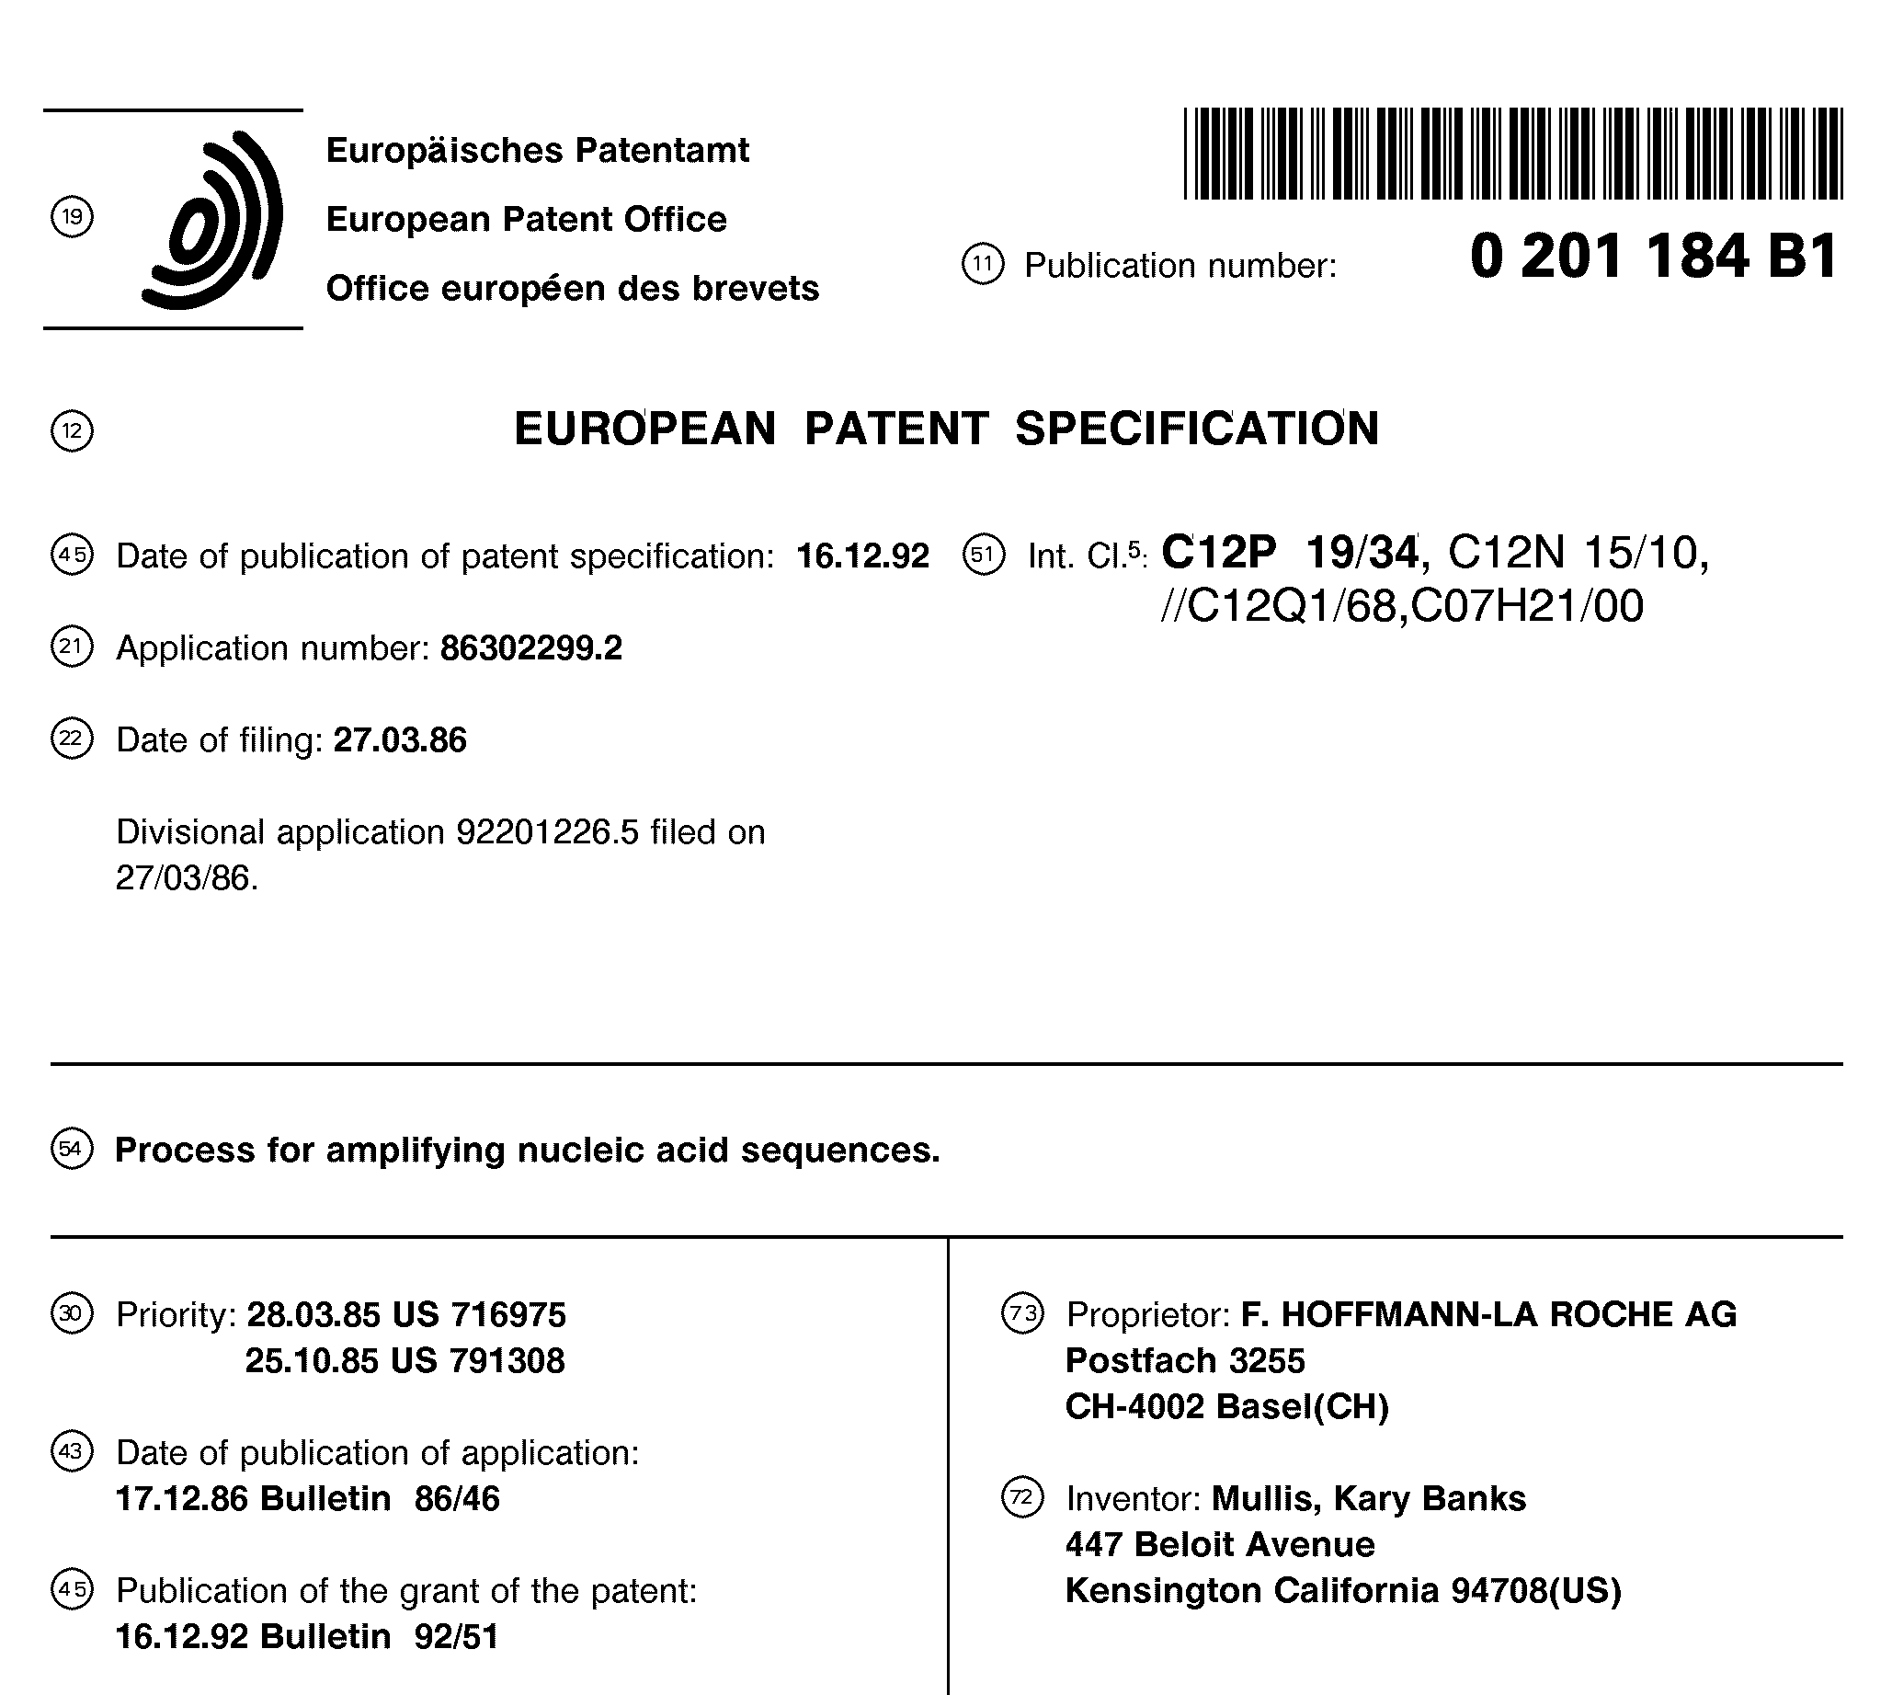
Notes:
This slide shows the front page of a sample patent as published.
The patent was applied for by Cetus Corporation, the employer of inventor Kary Mullis, who invented the Polymerase chain reaction, a basic tool of biotechnology.
Before the European Patent was granted, Cetus Corporation sold it and other related patents to Hoffmann-La Roche AG (reportedly for approximately USD 300 million). This is why the document shows Hoffmann-La Roche as the proprietor.
The inventor was awarded the Nobel Prize in Chemistry in 1993.

Slide 28
Go to the homepage http://worldwide.espacenet.com/?locale=en_EP
Search for areas/things which might be patentable in your case.

Slide 29
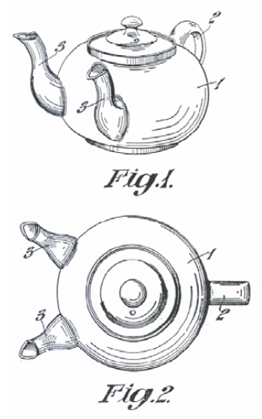
Structure of the description
Prior art
  Teapot with one spout
Drawback of prior art
  Time-consuming
Problem to solve
  Reduce filling time
Solution
  Provide a second spout
Advantage of the invention
  The time needed to fill multiple
  cups is reduced
Notes:
This slide shows the typical structure of a description in a patent. The description relates to the drawings. Often a picture is worth a thousand words!
The invention shown is from the UK. It can be found in patent application GB360253, which was filed in 1930.

Slide 30
What can be patented at the European Patent Office?
Inventions that are…
  new to the world (no previous public notice)
  inventive (i.e. not an "obvious" solution)
  susceptible of industrial application
NOT:
  Mere ideas not reduced to practice
  Software as such
  (but algorithms that achieve technical results)
  Business methods (except things like flexlån)
  Medical therapies, plant varieties, etc.
  …
See Articles 52 and 53 EPC in
http://www.epo.org/patents/law/legal-texts/epc.html
Notes:
This slide refers to patent applications filed with the European Patent Office (under the European Patent Convention, or EPC).
The patent will cover only those aspects of your invention that are new and inventive.
Note: The USA has a one-year grace period – you can apply for a US patent up to one year after having disclosed the invention to the public.
Inventions must have an industrial application in order to be patentable. However, the patent office does not examine whether the invention is of economic value. This requirement is only very rarely a practical hurdle for patent applications (exceptions exist for example in some fields of biotechnology).

Slide 31




What not to do when considering filing a patent application
No publication prior to filing
e.g. no article, press release, conference presentation/poster/proceedings or blog entry
No sale of products incorporating the invention prior to filing
No lecture or presentation prior to filing
except under a non-disclosure agreement (NDA)
Seek professional advice soon!
File before others do!
NDA
Notes:
Remember the "social contract"? If you have already revealed your invention to the public, you will have nothing to "trade", so you won't get a patent. It does not matter if it was you who made the invention public!
There is no problem if you present/publishing/sell your invention AFTER you have filed the patent application.
If you need to talk to potential customers or investors before filing a patent application, sign a non-disclosure agreement (NDA) with them first!

Slide 32
US patent law
First to invent.

Slide 33
Where to apply for a patent
National patent offices
  National patent valid only in the country where it is granted
  Non-residents can also apply for a patent
  One year of "priority" for subsequent applications
European Patent Office
  A European patent is equivalent to national patents in the countries where it is granted (the applicant chooses the countries)
Via the Patent Cooperation Treaty
  Just one application for up to 141 countries
  After the initial application phase, the international application leads to multiple national patent examination procedures
  Decisions with cost implications can be delayed until 30-31 months after filing (e.g. choice of countries to file in)
There is no such thing as an international patent!
Notes:
Within one year of the first filing of a patent application, applicants may file an application for the same invention with other patent offices. Such inventions are treated as if they were filed on the date of the first application (for the purposes of examining novelty and inventive step).
PCT applications can be filed at a national patent office, the EPO or with the World International Property Organization direct.
The PCT procedure allows for a single application which is later split into many national patent applications. The EPO accepts patent applications filed under the PCT in its capacity as a receiving office, international searching authority, international preliminary examining authority and/or designated or elected office. However, it is important to stress that there is no such thing as an "international patent".
There is no international patent as such, but there is such a thing as an international patent application procedure!

Slide 34
The patent procedure at the EPO
Optional
Opposition
period
expires
Search
report
Publication
of application
Publication
of grant
Application
18 months
Withdraw?
Approx. 4-5 years
9 months
Notes:
The search report is usually created before the patent application is published.
Applicants can withdraw their application at any time, e.g. if conflicting prior art is found.
If applications are withdrawn early enough, then the application is not published.
During the opposition period, third parties can oppose the patent on the grounds that it should not have been granted (opposition grounds are limited).
The reasons for the long time taken to grant a patent (not just at the EPO, but at most other patent offices too):
applicants have a long time to respond to communications from the patent office
there is a substantial backlog of applications due to a surge in patenting activity and international patenting
A published patent application will provide some limited protection even before it is granted (see Art. 67 EPC).

Slide 35
The PCT procedure
Optional
Possible prior patent application (priority)
PCT patent application
Publication
18 months after priority date
Applicant decides: preliminary examination?
22 months after priority date
No
Yes
Direct entry into
national/regional phase
Preliminary
examination
National phase:
30-31 months after first filing
Notes:
Main advantages:
One patent application for up to around 141 states.
National fees and translation costs delayed; occur only if and when the national phase is entered.
Entry into the national phase can be delayed by up to 30 months (EPO: 31 months) after filing.
Compared with the 12-month priority period: deferral of decisions and costs by up to 18 months!
Priority date = date of filing of the first patent application for an invention.

Slide 36
Go to the homepage http://worldwide.espacenet.com/?locale=en_EP
Find patent on: Polypeptide
Inventor : Kristensen
Applicant: Bioneer

Slide 37
Initial search report
See handout

Slide 38
Office action
See handout

Slide 39
Cost of a national patent application: Germany
Patent granted!
Patent
attorney
Apply for
patent
Annual fees
Year 3 4 5
Invention
Examination
EUR 1 000
to EUR 4 000
EUR 60
EUR 350
EUR 70
EUR 70
EUR 90
Total: EUR 1 700 - EUR 5 100
(depending on complexity of patent and extent of applicant's preparation!
Notes:
The estimated cost shown is the total cost up to grant of the patent.
The German Patent Office takes approximately three to five years to grant a patent.
Most patent offices require the payment of patent renewal fees to keep the application/patent valid. These fees are meant to eliminate worthless patents before the maximum term of 20 years.
Note: One patent on its own will often not be enough to effectively protect a whole new technology. This means that the total cost of patent protection might be substantially higher.

Slide 40
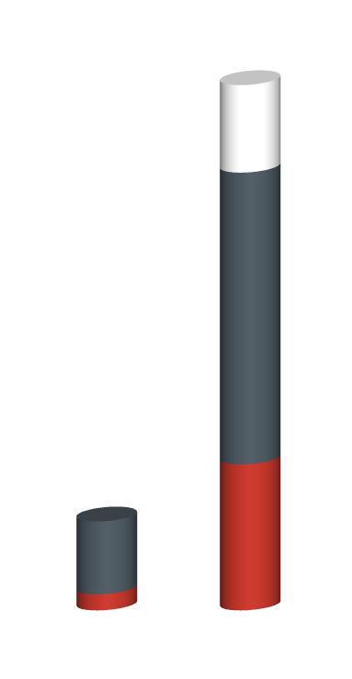
Cost of a European patent up to grant
Protection in (e.g.):
Germany
United Kingdom
France
Italy
Spain
Switzerland
EUR 3 000 translations*
EUR 10 000 patent attorney fees*
EUR 5 000 patent office fees*
German
patent
European
patent
* Estimated cost. Actual cost depends very much on the specifics of the individual case.
Notes:
Cost of a European patent compared with a German patent:
Higher fees charged by patent attorney
Higher fees charged by European Patent Office
Translations required (depending on countries chosen)
Note: The costs shown are up to the date of grant of the patent. Renewal fees due after that date are not included.

Slide 41
Imagine that you are working in a biotech company and have made an improvement to the production of a recombiant protein – would the company apply for patent?
1 ) yes
Send 'AU PK 1' to 42420321
2) no
Send 'AU PK 2' to 42420321
3) Do not know
Send 'AU PK 3' to 42420321
Std. rates apply. No premium charges
<number>/8

Slide 42
In groups discuss the question

Slide 43
Imagine that you are working in a biotech company and have made an improvement to the production of a recombiant protein – would the company apply for patent?
1) Yes
Send 'AU PK 1' to 42420321
2) No
Send 'AU PK 2' to 42420321
3) Do not know
Send 'AU PK 3' to 42420321
Std. rates apply. No premium charges
<number>/8

Slide 44
Advantages and disadvantages of patenting
Advantages
Disadvantages
Exclusivity enables investment and higher returns on investment
Strong, enforceable legal right
Makes invention tradable (licensing)
Reveals invention
to competitors
(after 18 months)
Can be expensive
Patent enforceable only after grant (this can take
4-5 years)
Notes:
Patent applications are always published 18 months after the date of filing, when they become available on free internet databases.
Patent applications may also offer a certain amount of protection, as competitors may well assume that the patent will be granted and might thus be discouraged from investing in commercialising a potentially infringing product.
Furthermore, some legal protection is also offered (see background notes).
Notes:
While patents are generally considered to be very strong and enforceable rights, even granted patents can be found to be invalid in court proceedings (i.e. although a patent office might have granted a patent in the first place, judges might later find that they should not have done so).
Enforcing patent rights may mean going to court, and this can be costly.

Slide 45
Alternatives to patenting
Information disclosure (publishing)
Cheap
Prevents others from patenting the same invention
Does not offer exclusivity
Reveals the invention to competitors
Secrecy (creating a trade secret)
Cheap (but there is the cost of maintaining secrecy)
Does not reveal the invention
No protection against reverse-engineering/duplication of invention
Difficult to enforce
"Secrets" often leak quite fast
Do nothing
No effort required
Does not offer exclusivity
Competitors will often learn details
Notes:
Information disclosure:
the invention can be published in any newspaper, magazine, journal, book or public prior art database.
publication prevents others from applying for a patent on the same invention and will thus keep the invention "patent-free" (however, other prior patents might effectively block its use).
Trade secrets:
frequently used, especially for inventions that do not qualify for patent protection and for production processes that cannot be reverse-engineered by analysing the end product. In the latter case, patent infringement would be very difficult to prove and thus patents might be ineffective.
on average, detailed technological information leaks out within a year.
Additional, complementary means of protecting inventions: lead-time advantages (time-to-market), learning curve effects, network effects (i.e. creating a user base), customer relations, etc. In surveys, these options are found to be at least as important as patent protection and other legal instruments.

Slide 46
How patents are used
Protecting products and processes
  Increasing turnover and profits
  Attracting investors
Licensing
Cross-licensing
Blocking competitors
Building reputation
…
Not used
Notes:
Most patents are worth less than EUR 300 000, but 1 out of every 100 is worth more than EUR 100 million (European PATVAL study).
Universities in the USA receive approximately USD 1 500 million - about 3% of their annual research budget – from patent licensing fees (AUTM US Licensing Survey 2004).
Results from a survey of more than 7 000 patents:
% of all patents
Protection of own products/processes 50%
Licensing only 6%
Licensing and use 4%
Cross-licensing 3%
Blocking competitors 19%
Not (yet) used 17%
(Substantial differences by country, industry sector and company size)
Source: Giuri et al., 2007.
Cross-licensing is very important for certain industries. Remember the mobile phone example: a common mobile phone has to use technology protected by so many patents that most mobile phone companies have made cross-licensing agreements to allow each other to use their respective patents.

Slide 47
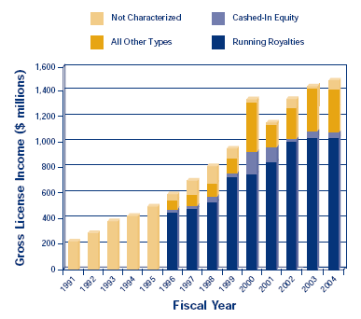
Licensing income of US universities
Optional
Source: AUTM US licensing survey 2004
Notes:
On average US universities collect about 3% of their research budget from licensing royalties (compared with 1.1% in Europe).

Slide 48
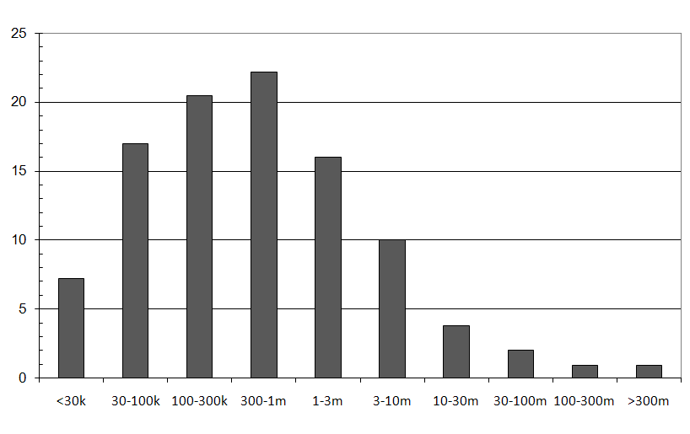
The value of European patents
Optional
Share of patents, %
Patent value
Notes:
The figures shown here represent the responses from a survey of more than 9 000 inventors of patents applied for at the European Patent Office in the 1990s. Inventors were asked in 2004, long after the patents had been applied for.
Average value: approximately EUR 6 million.
Median (50% worth less/more): EUR 300 000 = typical value.
Source: Ceccagnoli et al., 2005.

Slide 49
25% of all R&D efforts ...
… are wasted each year on inventions that have already been invented.
Don't start your R&D until you have done a search!
Notes:
Replication of R&D results costs anything up to EUR 60 000 million a year in Europe alone.
The Austrian Patent Office estimates that EUR 60 000 million are wasted per year in Europe, including EUR 1 000 million in Austria.
The President of the Austrian Inventor Association estimates (2005) that up to 10 000 of the 30 000 inventors who are active in Austria work "to no avail".
The technology transfer agency ProVendis estimates that 25% all of German R&D investment is wasted by duplicating R&D already done.
-> Review the literature (including articles and patents) before you start your project.
-> Search again at project milestones: your project might have changed and other inventors might have been active too.

Slide 50
Much information only available in patents
Published elsewhere
Published
in patents
80% found only in patents!
Where do secretive competitors publish their R&D?
Notes:
Approximately 80% of the information which can be found in patents is not available anywhere else in comparable detail.
Patents focus on how to make things work, while scientific articles focus on the scientific contribution.
-> Read patents as a complement to the scientific literature!
Also note that your competitors will "announce" their new products in patents if they want to have patent protection!
Source: Empirical studies.

Slide 51
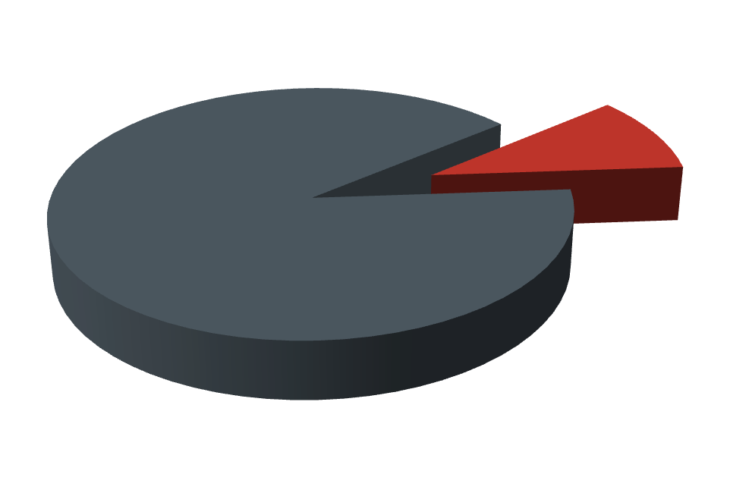
Solutions found in patent documents
90%
Free to use
10%
Protected
You can find many great solutions for free!
Notes:
Reasons why most patent documents describe inventions that are free to use:
Application rejected/withdrawn or patent invalidated
Payment of renewal fees discontinued (owner sees no further value in the patent)
Patent has lapsed (usually after 20 years)
"Old" solutions are not necessarily "outdated".
Examples: antibiotics, superconductors, the internet (the internet was invented in 1973).

Slide 52
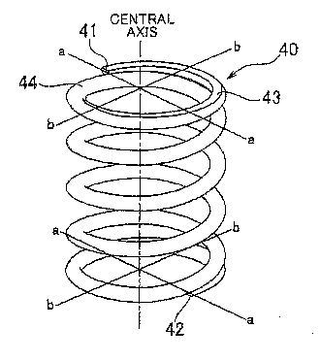
… but some basic knowledge is needed!
Beware of "naïve" keyword searches such as ...
Spring
"Energy storing means"
Notes:
Simple, "naïve" keyword searches have very limited effectiveness. Applicants frequently use broad concepts instead of intuitive keywords to describe their inventions, either to broaden the scope of the patent or to deliberately make it harder to find.
This and the following examples of "patent jargon" are meant to provide an amusing conclusion to the lecture. You may like to introduce them with a humorous comment, along the lines of: "We engineers like to call a spring a spring. But that's not how patent attorneys see it. Let's have a look at the language they use."

Slide 53
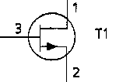
This kind of "jargon" is often used to broaden the scope of the patent ...
Transistor
"Semiconductor switching
device with a control electrode"

Slide 54
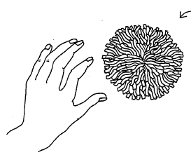
Sometimes, the applicant simply doesn't want his patent to be found …
Toy ball
"Spherical object with floppy filaments"

Slide 55
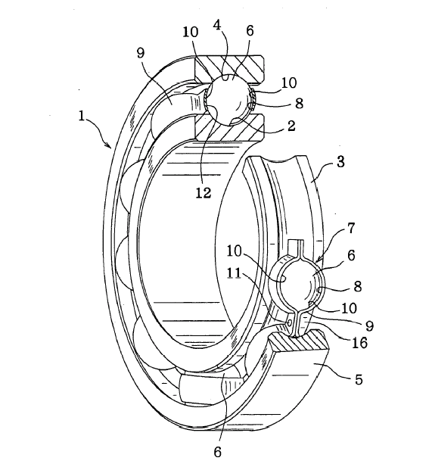
Sometimes, the applicant simply doesn't want his patent to be found …
Ball bearing
"A plurality of balls"

